Slide 1
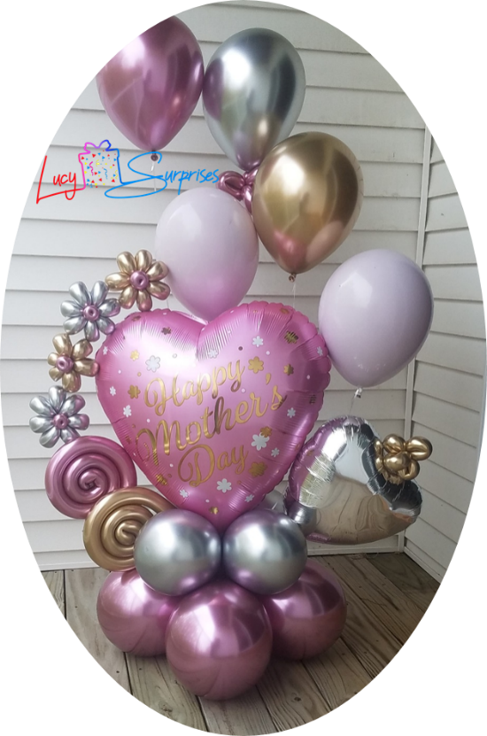
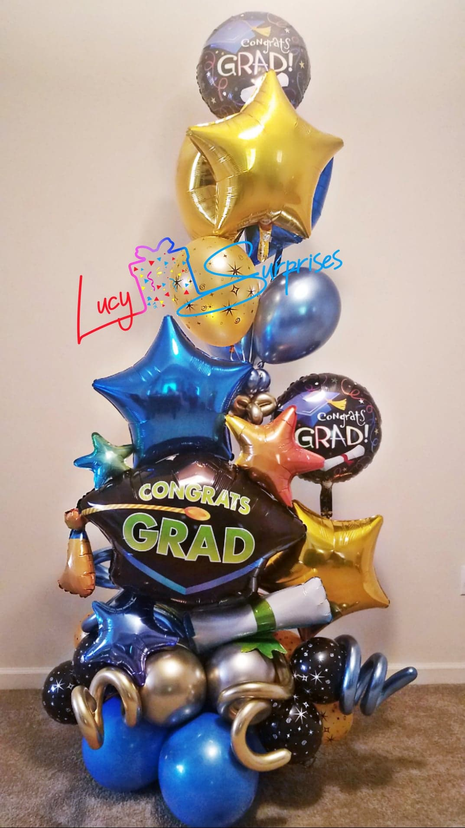
Example Model
or
Picture Example
Mini Bouquet: is a Balloon Bouquet in miniature version with Chic Style, seeks to recreate the motive to celebrate for our client in a simple way, with a touch of elegance and without excessive.
Es un Bouquet de Globos en versión miniatura con un estilo Chic, busca recrear el motivo a celebrar por nuestro cliente de una manera sencilla, con un toque de elegancia y sin excesos.
Price Range: $99.99 - $115
See more Example Models →
Small Bouquet: it is a balloon bouquet with fresh style that stands out in plain sight and denotes with simplicity the motive to celebrate by our client.
Es un Bouquet de Globos que destaca a la vista y denota con sencillez el motivo a celebrar por nuestro cliente.
Price Range: $120 - $134.99
See more Example Models →

Slide 2
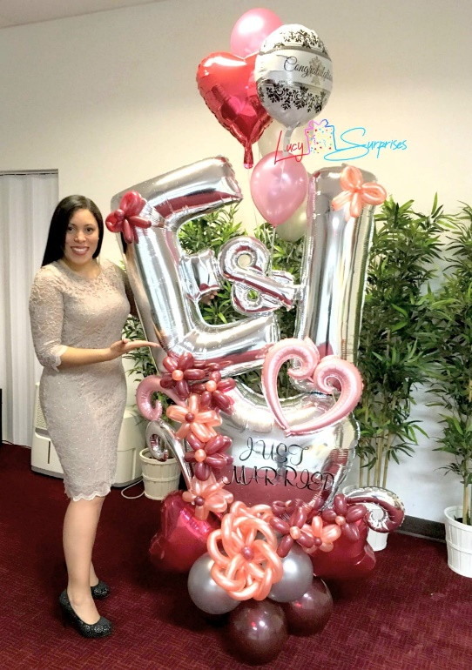
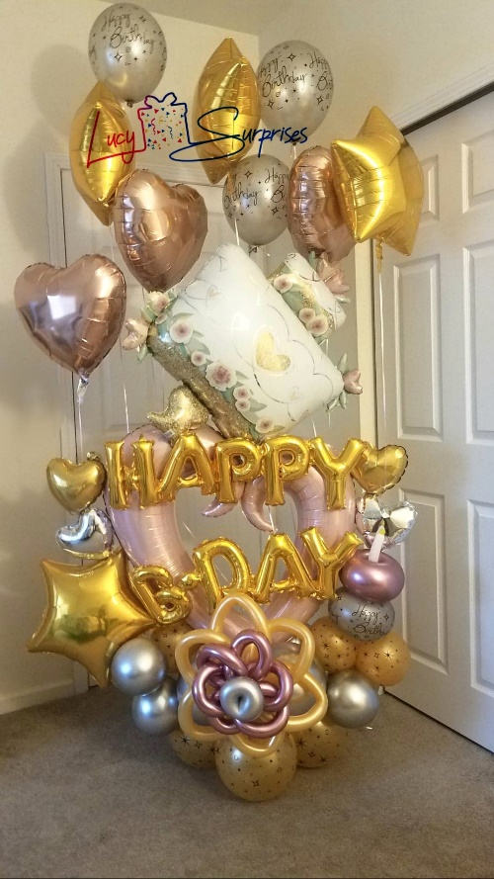
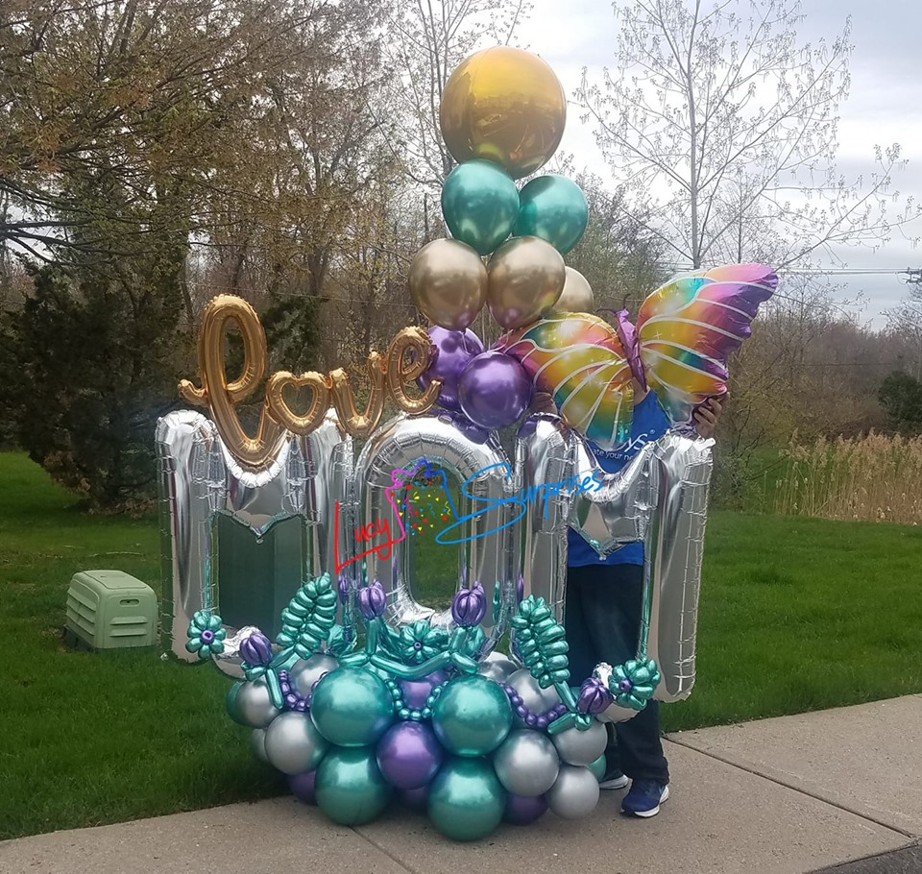
Example Model
or
Picture Example
Medium Bouquet: is a Balloon Bouquet remarkable, which striking for its beautiful decorative details to celebrate and fest that person or moment super special for you. This is our Most Popular Bouquet, because cause a Impressive Surprise Feeling in the persons that receive them.
Es un ramo de globos notable, que destaca por sus hermosos detalles decorativos para celebrar y festejar a esa persona o momento super especial para ti. Este es nuestro ramo más popular, porque causa una sensación de sorpresa impresionante en las personas que los reciben.
Price Range: $140 - $169.99
See more Example Models →
Large Bouquet:.
It is a balloon bouquet with fresh style que destaca a la vista y denota con sencillez el motivo a celebrar por nuestro cliente.
Price Range: $180 - $209.99
See more Example Models →

